Slide 1

How to crush your pre-thesis talk
Timothy A. Wencewicz
Associate Professor
Department of Chemistry
College of Arts & Sciences
Washington University in St. Louis
GSWC Pre-Thesis Workshop
Oct. 23, 2024

Slide 2
1. State the problem (and emphasis why it is important).

Slide 3
7,638,965,495

Slide 4
9,638,965,495
By 2050 …

Slide 5
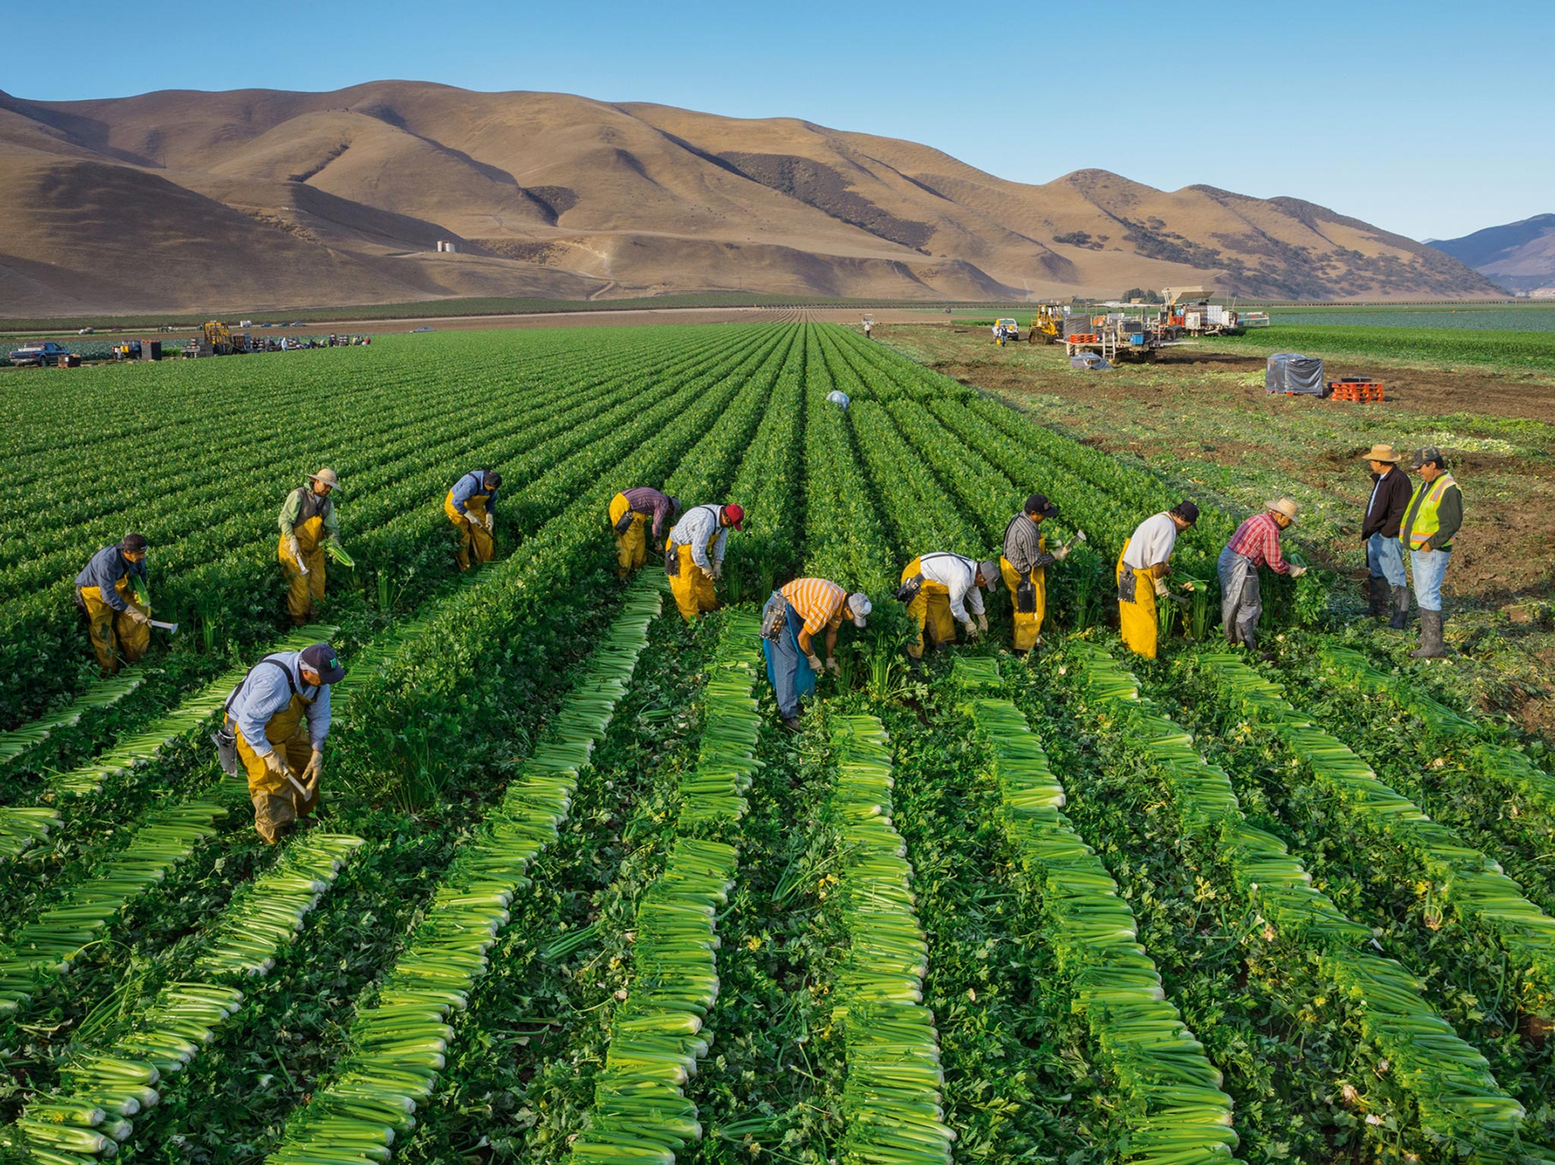
Feeding the Growing World
https://www.nationalgeographic.com/foodfeatures/feeding-9-billion/
Notes:
Farmers will need to produce more food in the next 50 years than in the past 10,000 years combined.
Freeze agriculture’s footprint. 2) Grow more on farms we’ve got. 3) Use resources more efficiently. 4) Shift diets. 5) Reduce waste.
In the words of Matt Damon, “We are going to have to science the shit out of this.”
Commensals: influence the plant ecosystem, impacts plant microbiome composition
Beneficials: nutrient supplementation (P/N), protection from pests and disease, enhance root growth, environmental tolerance

Slide 6
2. State your proposed solution(s).

Slide 7

The Plant Microbiome
phyllosphere
10 million microbes/cm²
commensals
beneficials
pathogens
rhizosphere
10 billion microbes/gram soil
https://monsanto.com/app/uploads/2017/06/the-plant-microbiome.pdf
Notes:
30,000 unique species in rhizosphere
Farmers will need to produce more food in the next 50 years than in the past 10,000 years combined.
Freeze agriculture’s footprint. 2) Grow more on farms we’ve got. 3) Use resources more efficiently. 4) Shift diets. 5) Reduce waste.
In the words of Matt Damon, “We are going to have to science the shit out of this.”
Commensals: influence the plant ecosystem, impacts plant microbiome composition
Beneficials: nutrient supplementation (P/N), protection from pests and disease, enhance root growth, environmental tolerance

Slide 8
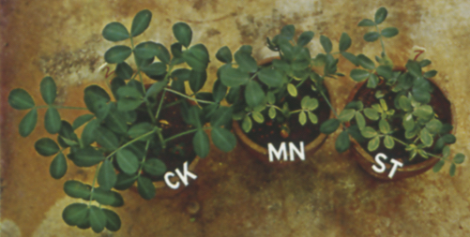
The Plant Microbiome
control
+Mn
autoclaved soil
Boyd, H. W. Plant and Soil 1971, 34, 133-144.
Notes:
Argentine peanuts

Slide 9
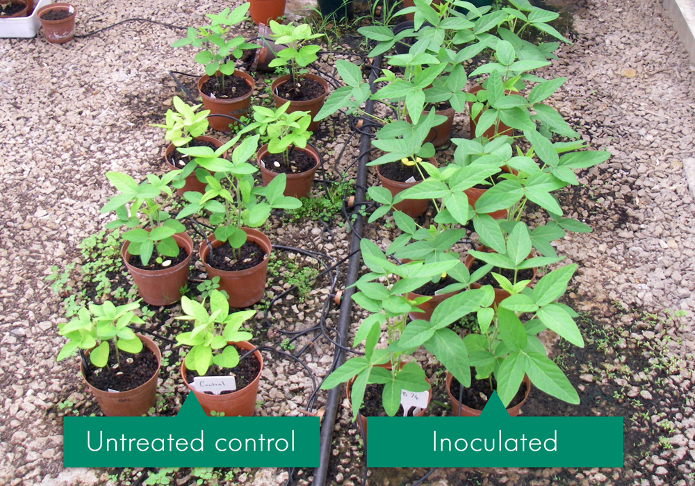
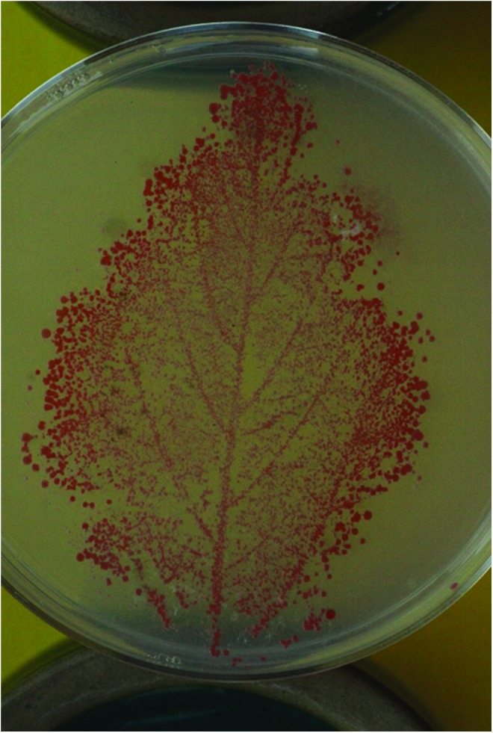
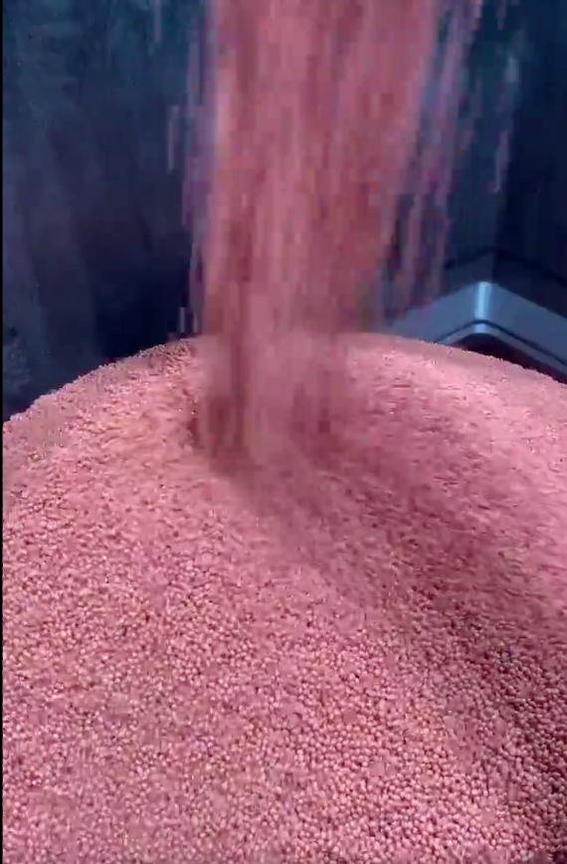
Plant Probiotics (seed treatments)
$4.7 Billion
Market in 2018
https://www.andermattbiocontrol.com/sites/products/biostimulants-bioinnoculants/rhizobia-soybean.html
https://newleafsym.com/see-what-terrasym-technology-looks-like/terrasym-401/
Rhizobia (Andermatt)
Terrasym (NewLeaf)
Notes:
Picture shows soybean growth boost by Rhizobia.
Methylobacteria.

Slide 10
3. Identify knowledge gaps (and describe why they must be filled to advance the field).

Slide 11
Plant Probiotics (seed treatments)
$4.7 Billion
Market in 2018
Needs:
More robust probiotic strains.
Defined genetic strain lines.
Defined metabolic signatures.
Broad soil tolerance.
Naturally selected, not engineered.
Questions:
What is the role of a given probiotic strain?
What molecules are being produced?
What are the functions of conserved molecules?
Are probiotics better than chemicals?
What is the dominate trait providing benefit?
https://newleafsym.com/see-what-terrasym-technology-looks-like/terrasym-401/
Terrasym (NewLeaf)
Notes:
Picture shows soybean growth boost by Rhizobia.
Methylobacteria.

Slide 12
4. Summarize past and current efforts to fill these knowledge gaps.

Slide 13
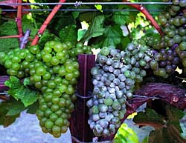

Biopesticides (leaf treatments)
Bacillus spp.
>20 antibiotics
produced!
$6.6 Billion
Market by 2020
Wu et al. Sci. Rep. 2015, 5, 12975; http://pubs.acs.org/cen/coverstory/8126/print/8126greenchemistry.html
Notes:
Surfactin, difficidin, anticapsin – treats powdery mildew on grapes
GroBig – feed pellets for chickens, probiotic in poop as crop fertilizer
Biopesticide market will be worth 6.6 billion by 2020.
Nutrient fixation, bioremediation, pathogen suppression

Slide 14
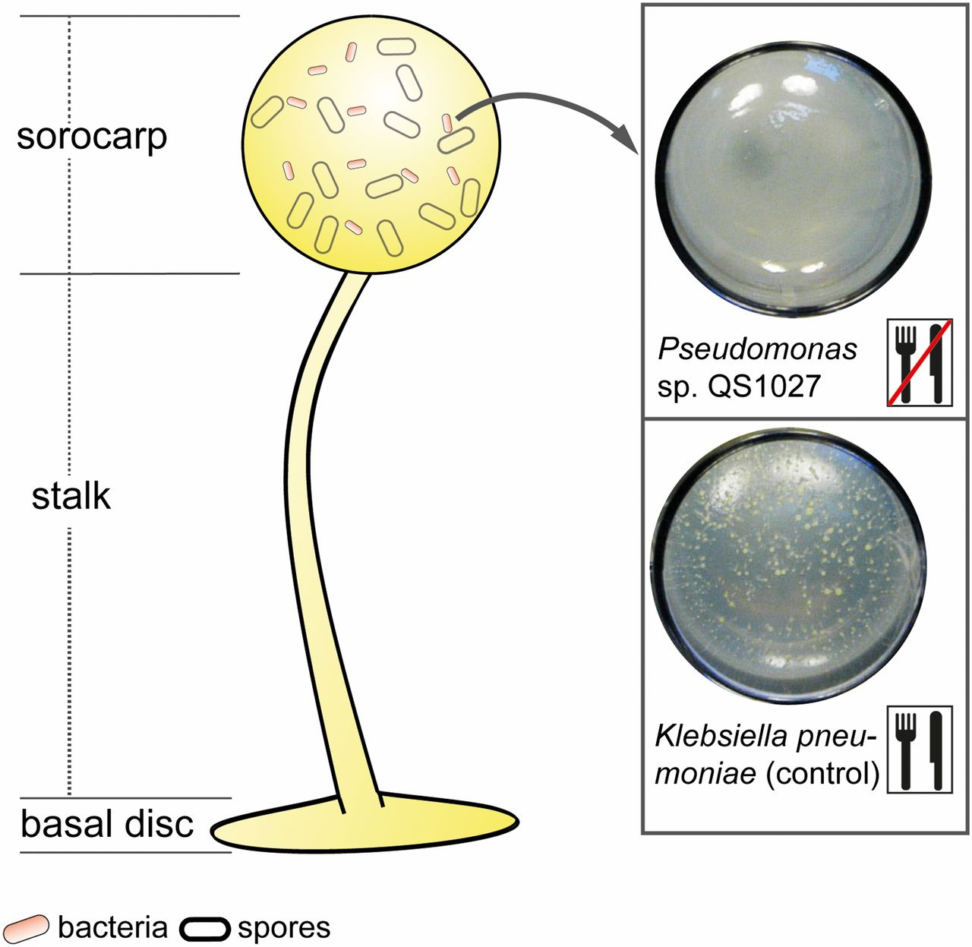
Rhizosphere Pseudomonads
Arp, J.; et al. PNAS 2018, 115, 3758-3763.
Notes:
Dictyostelium discoideum – bacterivorous amoeba

Slide 15
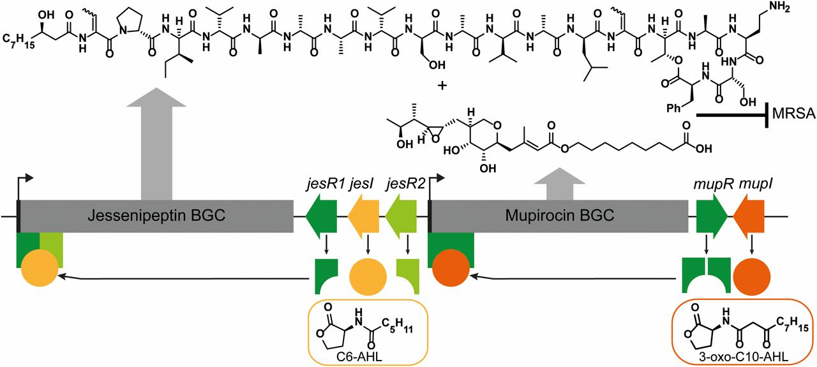
Rhizosphere Pseudomonads
Arp, J.; et al. PNAS 2018, 115, 3758-3763.

Slide 16
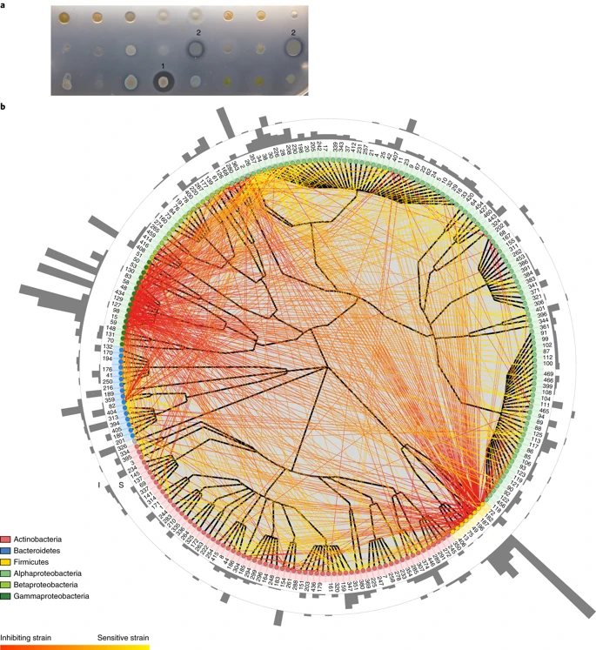
The Plant Antibiotic’ome
224 strains
>1,000 BGCs
Hundreds of Unknowns
phyllosphere
Arabidopsis
rhizosphere
Piel, Vorholt, et al. Nat. Micriobiol. 2018, 3, 909-919.
Notes:
30,000 unique species in rhizosphere

Slide 17
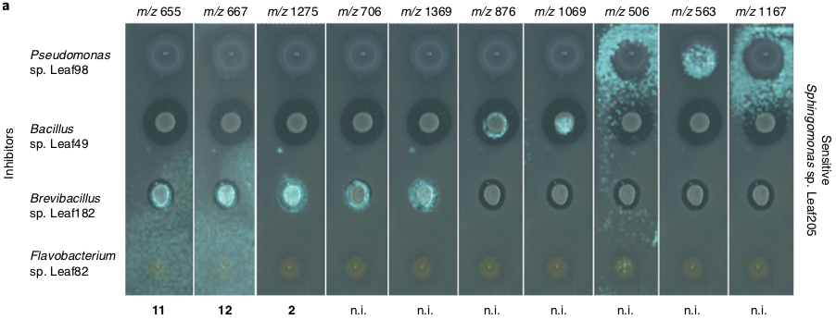
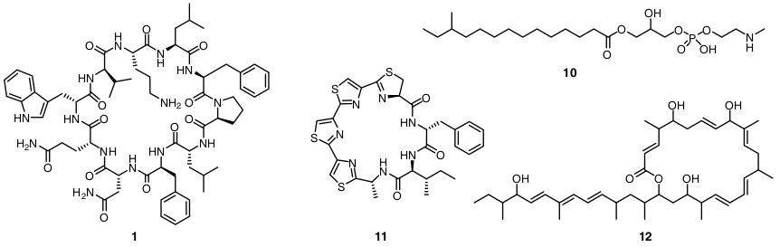
The Plant Antibiotic’ome
Piel, Vorholt, et al. Nat. Micriobiol. 2018, 3, 909-919.
Notes:
50,000 pairings were monitored for inhibitory activity.
Compound 12 = macrobrevin (structure novel, trans-AT PKS-derived)

Slide 18
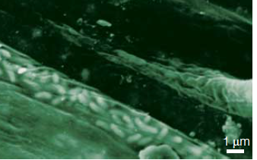
Antibiotics from Pseudomonads
P. fluorescens on tomato root
Wells, J. S.; Trejo, W. H.; Principe, P. A.; Sykes, R. B. J. Antibiotics 1984, 37, 802-803.
Chin-A-Woeng, T.F.C.; et al. Mol. Plant Microbe Interact. 1997, 10, 79-86.
Notes:
Widespread, >24 strains from diverse environments

Slide 19
5. State your hypothesis.

Slide 20
I hypothesize that the antibiotic obafluorin plays a conserved protective role in plant health through pathogen suppression on the plant roots that will boost the efficacy of Pseudomonas-based plant probiotics.
P. fluorescens on tomato root
Notes:
Widespread, >24 strains from diverse environments

Slide 21
6. State your goals.

Slide 22
I aim to evaluate the occurrence rate of obafluorin in the plant rhizosphere and elucidate the mechanistic role of obafluorin in plant health and pathogen suppression.
P. fluorescens on tomato root
Notes:
Widespread, >24 strains from diverse environments

Slide 23
If successful, my research findings will guide the use of obafluorin and obafluorin-producing antibiotics as agrochemicals and probiotics, respectively, for improving crop production and sustainability.
P. fluorescens on tomato root
Notes:
Widespread, >24 strains from diverse environments

Slide 24
7. Outline your approach (how you will test your hypothesis) and anticipated findings (these are your specific aims).

Slide 25
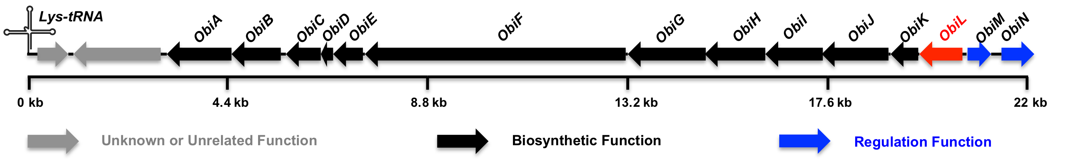
Specific Aim 1: Determine the antibiotic biosynthetic capacity of rhizosphere Pseudomonads and assess the occurrence rate of obafluorin.
P. fluorescens
phyllosphere
Arabidopsis
A plant to microbe to genes to molecule discovery platform is proposed.
rhizosphere
Notes:
Widespread, >24 strains from diverse environments

Slide 26
Specific Aim 1a: Build a library of rhizosphere Pseudomonads.
P. fluorescens
phyllosphere
Arabidopsis
Pseudomonads will be isolated on selective growth media from diverse soil environments.
rhizosphere
Notes:
Widespread, >24 strains from diverse environments

Slide 27
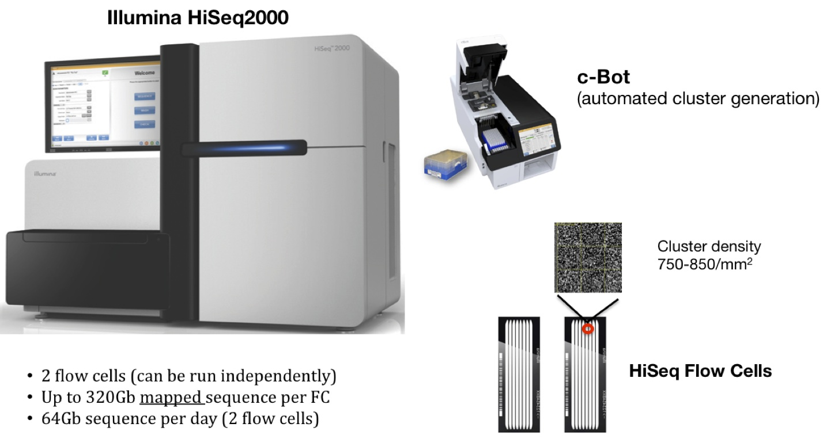
Specific Aim 1b: Sequence genomes of Pseudomonad library.
phyllosphere
Arabidopsis
Genomes will be sequenced by HiSeq Illumina and assembled using Velvet software.
rhizosphere
Notes:
Widespread, >24 strains from diverse environments

Slide 28
Specific Aim 1c: Identify antibiotic BGCs.
phyllosphere
Arabidopsis
Antibiotic biosynthetic gene clusters will be identified using Antismash analysis and structures will be predicted using GRAPE software.
rhizosphere
Notes:
Widespread, >24 strains from diverse environments

Slide 29
8. Teach your committee members (what they need to know to understand your approach).

Slide 30
9. Summarize your preliminary findings (if available).

Slide 31
10. Anticipated challenges & pitfalls (How will you handle these?).

Slide 32
11. Impact statement (if successful, my PhD research will …)

Slide 33
Remember, you are telling a story (that is still being written).

Slide 34
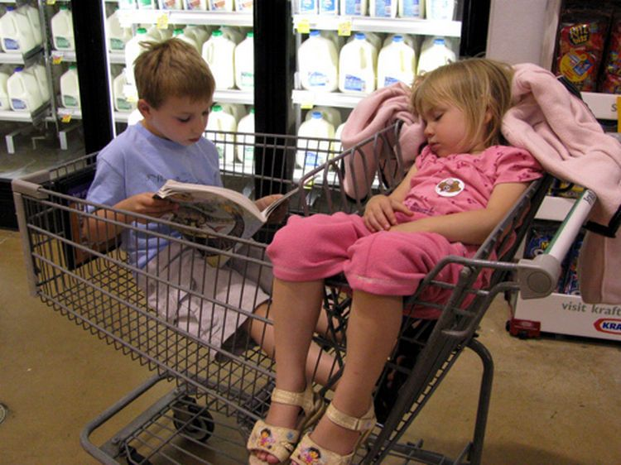
Not a bedtime story.

Slide 35

Not a horror story.

Slide 36

But an adventure.

